Slide 1

Jira administration
Notes:
Application Lifecycle Management
Version Control & Branching Strategy
Continuous Integration
Continuous Code Inspection
Testing Automation
Deployment Automation
Infrastructure as Code
Continuous Testing
Environments Equivalent to Production
Continuous Monitoring Continuous Delivery & Deployment
Automation techniques to optimize collaboration across Development and Operations

Slide 2

JIRA Overview
What is JIRA?
JIRA is a proprietary issue tracking product, developed by Atlassian, Inc. It provides bug tracking, issue tracking, and project management functions.
It lets you prioritize, assign, track, report, and audit your ‘issues’, from software bugs and helpdesk tickets to project tasks and change requests.
More than just an issue tracker, Jira is an extensible platform that you can customize to match your business processes.
JIRA is used for issue tracking and project management by over 25,000 customers in 122 countries around the globe.

Slide 3






JIRA Applications
What is it comprised of?

Slide 4
JIRA Applications
What is it comprised of?
Provides a workflow management system that you can use for many things, including running projects, tracking assets, and basically anything that requires work moving through a workflow.
Software development planning tool that provides agile boards, development tool integrations, and reporting for teams using Scrum or Kanban.
Collaborative IT service desk with a powerful ticketing system, a self-service knowledge base and real-time reporting.

Slide 5


JIRA Features
What it does?
Bugs / Change Request Tracking
Help-desk / Support / Customer Service
Project Management
Task Tracking
Requirements Management
Workflow / Process Management

Slide 6
Agile Concepts
How we use Jira For Agile Development?
Better Visibility
- it solves a lot of problems, just writing down and posting the things people were working on, raise a visibility of what was going on
Better Prioritization
- one of the things resulted from better visibility
Less downtime between tasks
- time tracking feature enables users to record the time they spend working on issues
Improved teamwork
- a tracking system helps to make sure to minimize the time between actually doing work
6

Slide 7
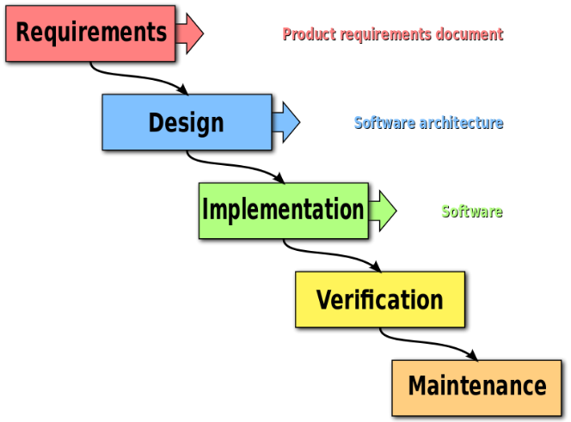
Waterfall Concepts
Why Waterfall Methodology is not advisable to use in Jira?
With this figure, you will create consecutive issues for all tasks.
But in modern agile methodologies provide a far better view of the iteration process in Software Development.
Copyright © 2016 Accenture All rights reserved.
7

Slide 8
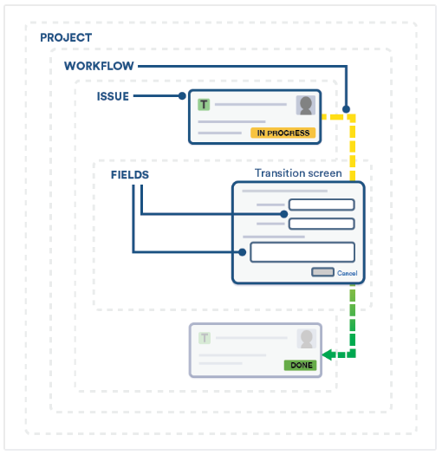
JIRa issues
Configuring Issues
An issue represents an action that has to be done. That action can be a task, a bug, a feature request or any type of action your organization might need to work with. Issues are the core of the Jira applications since all the team collaboration happens around the work items and their organization.
You can customize your own issue types creating issue sets associated per projects, and even per permission types.

Slide 9
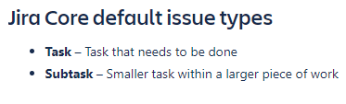
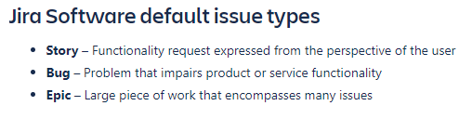
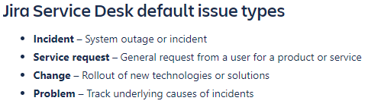
Jira issues
Issue Types
Your teams can collaborate in Jira applications by breaking down pieces of work into issues. Issues can represent tasks, software bugs, feature requests or any other type of project work.
Each Jira application comes with default issue types to suit the needs of your projects and teams. Get started with these default issue types or create your own. Here's an example of specific issue types within each Jira application:

Slide 10
Jira issues
Issue Type Scheme
As a Jira administrator, you can group issue types into issue type schemes to make it easier for your team to select the right type when creating issues in their project. Issue type schemes can also minimize the maintenance work required when administering several projects.
An issue type scheme lets you:
Set the available issue types for a project
Set the default issue type and order of issue types when creating an issue
Share the same group of issue types across multiple projects
As an example, you can set up an issue type scheme for your team of developers working in a software project. You can then add the bug and feature issue types to this scheme and apply it to any other projects that contain similar pieces of work.

Slide 11
Jira issues
Issue Fields And Statuses
FIELD | DESCRIPTION
Project | The parent project to which the issue belongs.
Key | A unique identifier for this issue. For example, ANGRY-304 (The characters to the left of the hyphen represent the project the this issue belongs to).
Summary | A brief, one-line summary of the issue. For example, "Red Angry Nerd is scary."
Type | A category for the issue, like "Task", "Epic", or "Bug". See below for a list of types.
Status | The stage the issue is currently at in its lifecycle (workflow)
Priority | The importance of the issue in relation to other issues. (See below for a list of priorities).

Slide 12
Jira issues
Issue Fields And Statuses
FIELD | DESCRIPTION
Resolution | A record of the issue's resolution, if the issue has been resolved or closed.
Affects Version(s) | Project version(s) for which the issue is (or was) manifesting.
Fix Version(s) | Project version(s) in which the issue was (or will be) fixed.
Component(s) | Project component(s) to which this issue relates.
Labels | Labels categorize and can group related issues
Environments | The hardware or software environment to which the issue relates.
Description | A detailed description of the issue.
Links | A list of links to related issues. (Strikethrough text, like this, indicates that an issue has been resolved.)

Slide 13
Jira issues
Issue Fields And Statuses
FIELD | DESCRIPTION
Assignee | The person to whom the issue is currently assigned. Note that you cannot assign issues to a user group.
Reporter | The person who entered the issue into the system.
Votes | The number shown indicates how many votes this issue has.
Watchers | number shown indicates how many people are watching this issue.
Due | The date by which this issue is scheduled to be completed
Created | The time and date on which this issue was entered into Jira.
Updated | The time and date on which this issue was last edited.
Resolved | The time and date on which this issue was resolved.
Estimate | The Original Estimate of the total amount of time required to resolve the issue, as estimated when the issue was created.

Slide 14
Jira issues
Issue Fields And Statuses
FIELD | DESCRIPTION
Remaining | The current estimate of the remaining amount of time needed to resolve the issue.
Logged | The sum of the Time Spent from each of the individual work logs for this issue.
Develpment | If you use Bitbucket to manage your code repositories, you can create code branches in your code development tools directly from Jira issues.
Agile | Lets you view your issue on your Scrum or Kanban board.
Service Deck | Lets you view request participants and view the equivalent request in the customer portal

Slide 15
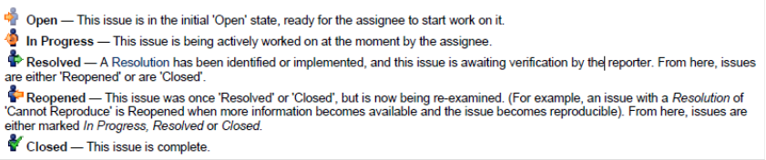
Jira Issue
Issue Fields And Statuses
Status:
Open – This issue is in the initial ‘Open’ state, ready for the assignee to start work on it.
In Progress – This issue is being actively worked on at the moment by the assignee.
Resolved – A Resolution has been identified or implemented, and this issue is awaiting verification by the reported. From here, issues are either ‘Reopened’ or are ‘Closed’.
Reopened – This issue was once ‘Resolved’ or ‘Closed’, but is now being re-examined. (For example, an issue with a Resolution of ‘Cannot Reproduce’ is Reopened more information becomes available and the issue becomes reproducible). From here, issues are either marked In Progress, Resolved or Closed.
Closed – This issue is complete.

Slide 16
Jira issues
Issue Priorities
!
Highest — Highest priority. This problem will block progress.
High — Indicates that this issue is causing a problem and requires urgent attention. Medium — Indicates that this issue has a significant impact. Low — Indicates that this issue has a relatively minor impact. Lowest — Lowest priority.
Issue

Slide 17
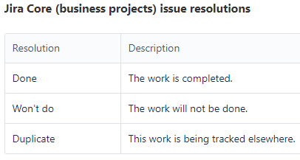
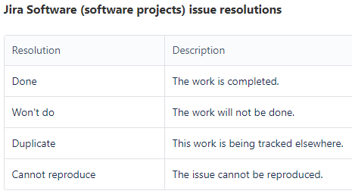
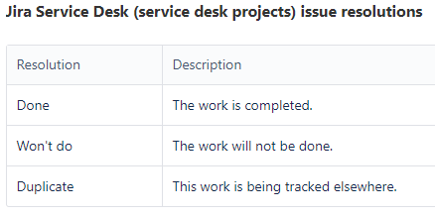
Jira issues
Issue Resolutions
An issue can be completed, or resolved, in many ways. An issue resolution is usually set when the status is changed. The default resolutions are listed below. Your administrator may have customized these to suit your organization.
Once an issue is resolved (that is, the issue's Resolution field is filled in), references to that issue show the key in strikethrough text

Slide 18

Jira issues
Issue Custom Fields
Jira application issues are made up of fields. You can choose any number of fields to appear when creating, editing, or transitioning issues. You can also create custom fields for teams working on issues within any of your Jira projects. Custom fields allow people to add information specific to your team's needs.

Slide 19
Jira issues
Issue field configurations
A field configuration lets you define the behavior of all issue fields, including custom fields, that are available in your Jira applications. For each field, a field configuration lets you set:
The description that appears under the field when an issue is edited
Whether the field is hidden or visible
Whether the field is required or optional
Which renderer to use for text fields

Slide 20

Jira issues
Issue Field Configuration Schemes
Issue field configuration schemes let you apply a field configuration to all issues of a certain type. When you want to change the fields that appear on all Bug issues types in a certain project, you can do so by simply configuring the associated field configuration scheme. You can also save time by reusing the same field configuration for issue types across multiple projects.

Slide 21
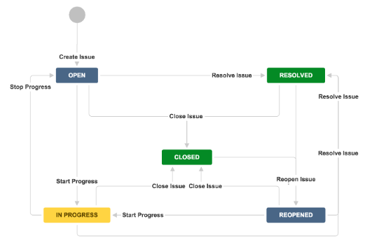
Jira issues
Issue Workflows
You can define the lifecycle of a piece of work (known as an issue type) by setting up an issue workflow. Workflows represent business processes and allow you to set the statuses and transitions each type of issue goes through.
There are a few ways to set up workflows across all of your Jira applications:
Create your own workflow
Import workflows from the Atlassian Marketplace
Copy and edit the default workflow

Slide 22

Jira issues
Issue Workflows Schemes
Workflow schemes let you define the lifecycle for different types of work across multiple projects. Within a workflow scheme, you can add one or more workflows and associate each workflow with any number of issue types. You can then apply that workflow scheme to multiple projects.

Slide 23

Jira issues
Configuring Issue-level Security
Issue security levels are created within issue security schemes and let you control which user or group of users can view an issue. When an issue security scheme is associated with a project, its security levels can be applied to issues in that project. Sub-tasks will also inherit the security level of their parent issue.
Note, if issue security levels are available but aren't set, the project permissions will then be applied.

Slide 24

Jira issues
What Is An Issue Collector?
The issue collector allows you to easily embed a Jira feedback form into your own web site. This form is typically accessed by clicking a 'trigger' tab exposed along the edge of pages in your web site.
When used by people visiting your web site click this trigger tab and submit the resulting Jira feedback form, an issue is conveniently created in Jira.
Visitors to your web site do not require a user account in Jira to use the Jira feedback form.

Slide 25
Using Report
What are the types of reports?
Burndown Chart (for Scrum boards only) - Shows the actual and estimated amount of work to be done in a sprint
Control Chart - Show the cycle time (or lead time) for your product, version or sprint.
Cumulative Flow Diagram - It is an area chart that shows the various statuses of work items for a particular time interval.
Epic Burndown (for Scrum boards only) - Shows you how your team is progressing against the work for a epic.
Epic Report (for Scrum boards only) - Shows a list of complete, incomplete and unestimated issues in an epic.

Slide 26
Using Report
What are the types of reports?
Release Burndown (for Scrum boards only) - Shows you how your team is progressing against the work for a release.
Sprint Report (for Scrum boards only) - Shows the list of issues in each sprint.
Velocity Chart (for Scrum boards only) - Shows the amount of value delivered in each sprint, enabling you to predict the amount of work the team can get done in future sprints.
Version Report (for Scrum boards only) - Shows your team's progress towards completion of a version.

Slide 27
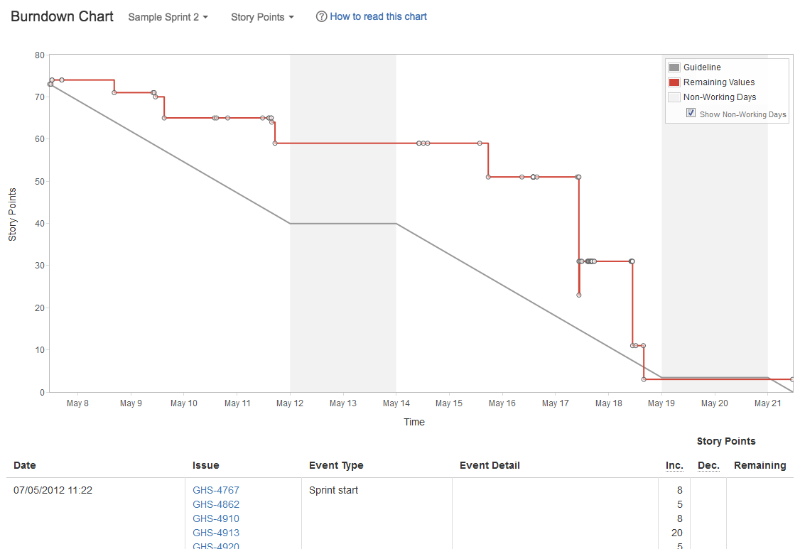
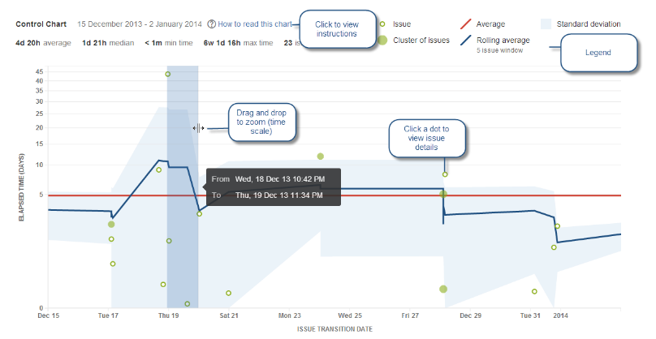
Using report
Burndown Chart
Control Chart

Slide 28
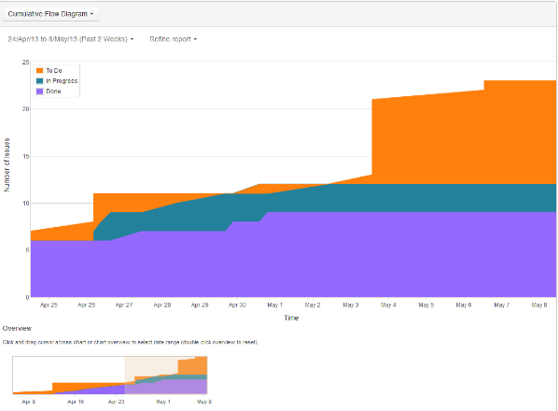
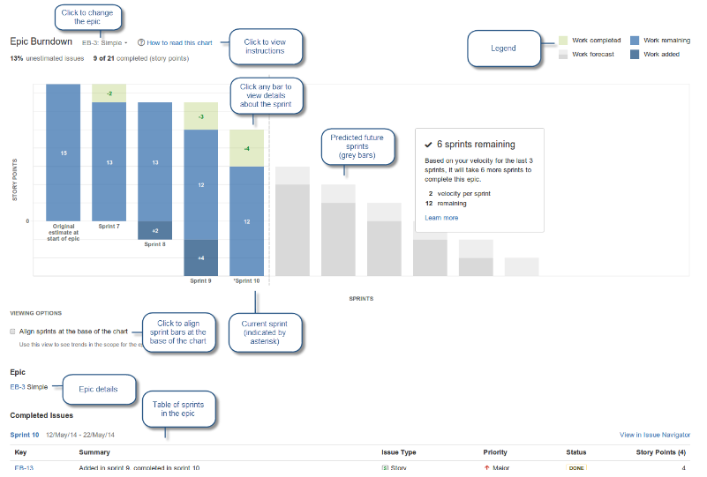
Using report
Cumulative Flow Diagram
Epic Burndown

Slide 29
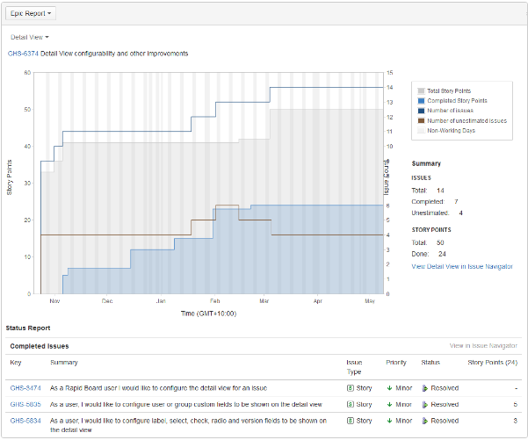
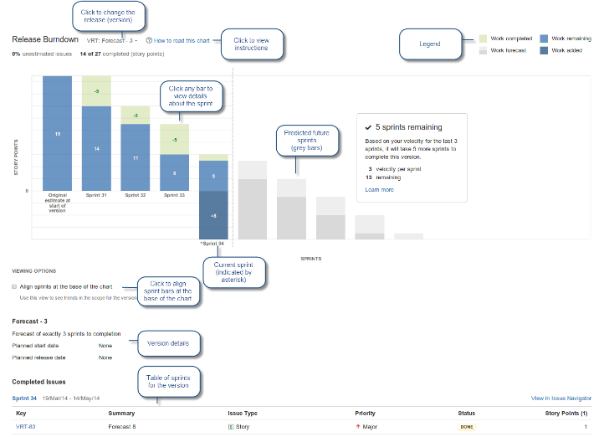
Using report
Epic Report
Release Burndown

Slide 30
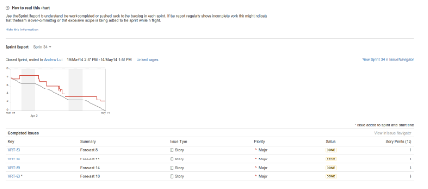
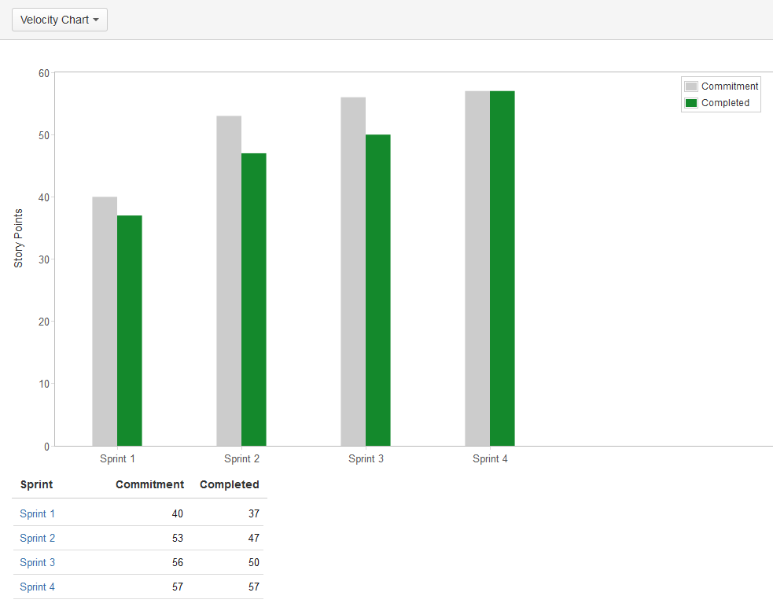
Using Report
Sprint Report
Velocity Chart

Slide 31
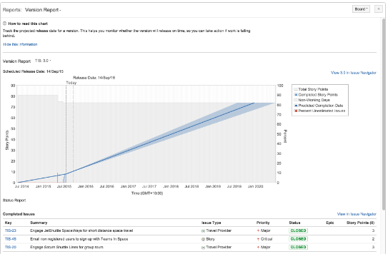
Using report
Version Report

